Slide 1
Telco Customer Churn Analysis
Han Yew Yong Matthew ID: 1881707B
Artificial Intelligence Solutions & Development

Slide 2
Introduction
This is a project to predict mobile customers churn using algorithms such as logistic regression, random forest and support vector machine.
Customers are the lifeblood of any companies. In a highly competitive mobile services market, retaining customers is as important as finding new ones. It would be ideal if telco companies could detect customers with high probability to churn and do the necessary customer recovery services to retain the customer.
The same logic can be applied to employee churn for HR departments.

Slide 3
Data Preparation and Feature Selection
Dataset from Kaggle
The cleaning process can be broken down into the following below.
‘TotalCharges’ column contains NaN values. After a browse of our data, I noticed these are rows with ‘Tenure’ = 0. It could be a reason why customers churn hence, I keep the rows and set the NaN values to 0.
As most of the columns are of categorical nature, a type conversion into 1 and 0 representation was performed for the machine learning algorithm to process.
The customer ID column was removed as we don’t need to feed that into the machine.
A plot of the correlation matrix shows that ‘TotalCharges’ is highly correlated with ‘Tenure’ and ‘MonthCharges’. To avoid multicollinearity in our logistic regression model, the ‘TotalCharges’ was removed.
A look at the ‘Churn’ column shows that the dataset displays class imbalanced problem. To solves this, the dataset could be upsampled or downsampled. Downsampled was chosen so that every row could describe a unique customer.
Lastly, the prepared data is split into training set and testing set.

Slide 4
Methods of Analysis
Logistic Regression
Random Forest Classifier
Support Vector Machine

Slide 5
Methods of Analysis
Accuracy Score
The ratio of correctly predicted observation to the total observed.
Classification report
Displays the precision, recall, F1 and support scores.
Confusion matrix
To describe the performance of a classification model on a test set for which true values are known.
ROC curve
A plot of the true positive rate against the false positive rate for different possible cutpoints of a diagnostic test.

Slide 6
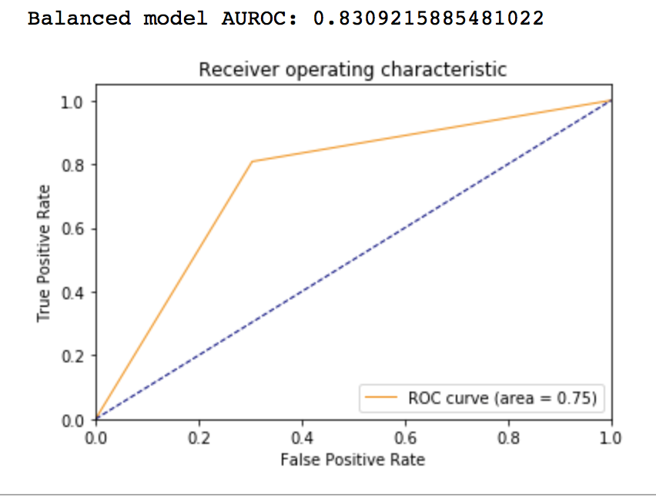
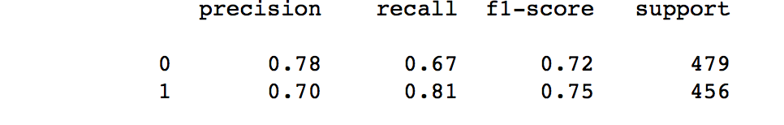
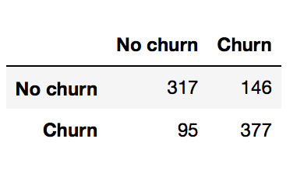
Logistic Regression
Accuracy score = 0.74
Classification report
Confusion matrix
ROC plot

Slide 7
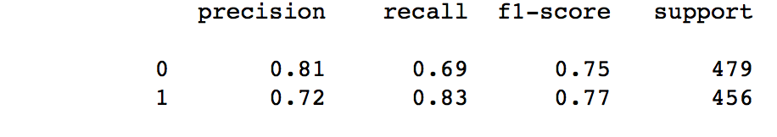
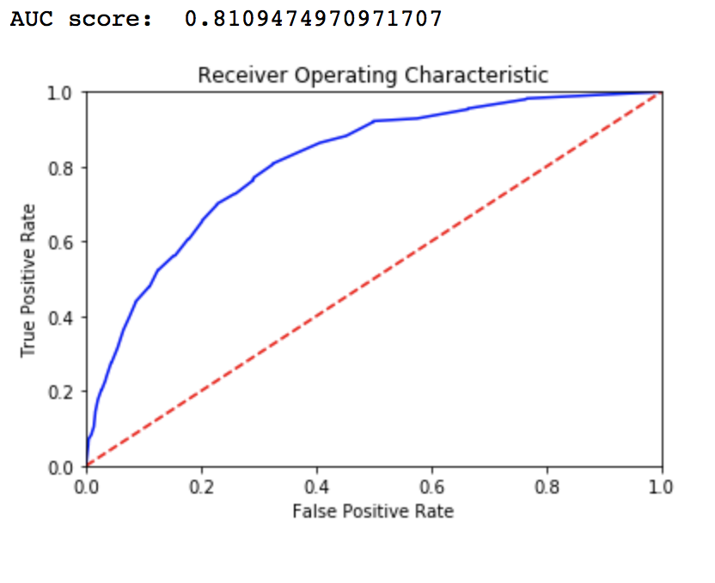
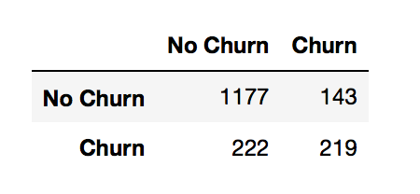
Random Forest Classifier
Accuracy score = 0.79
Classification report
Confusion matrix
ROC plot

Slide 8
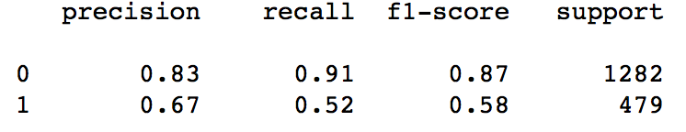
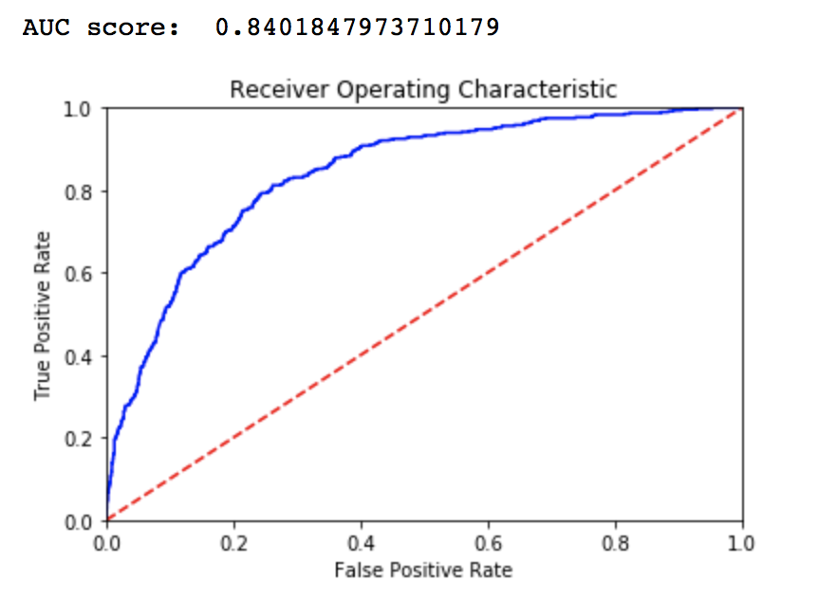
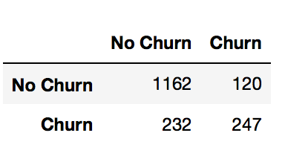
Support Vector Machine
Accuracy score = 0.80
Classification report
Confusion matrix
ROC plot

Slide 9
Conclusion
SVM is the best performing in this case.
Every single step of the data science workflow is important.
Data preparation is as important as finding the accurate model.
If time permit, I would experiment with more algorithm or alternatively, tune the hyperpameters of SVM to make it more accurate.
Also, I would chart the coefficients of the features to find the ones with the most impact on the churn.

Slide 10
References
Websites:
-www.dataschool.io
-www.dataskunksworks.com
-www.Kaggle.com
-www.elitedatascience.com
Books
Python for Data Science Handbook

